Slide 1
Agile Development
Chapter 03
Punjab University College of Information Technology

Slide 2
Agile Development – For handling changes

Slide 3
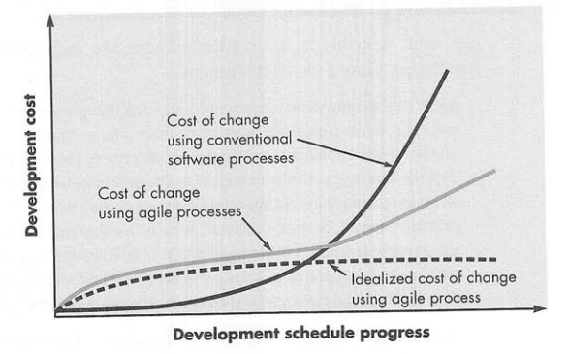
Agile Development
The cost of changes increases nonlinearly as a project progresses
Agile team is a nimble team able to appropriety respond to changes

Slide 4
Agile Development
Agile development is all about managing changes
Changes in
the software being built
changes to the team members
changes because of new technology
changes of all kinds that may have an impact on the product they build or the proiect that creates the product.

Slide 5
Agile Development
How do we create a process that can manage unpredicability?
Agile Process Model is adaptable
Agile process model must adapt incrementally
12 principles for those who want to achieve agility
Highest priority is to satisfy customer
Welcome change requirement, even in late development
Deliver working software frequently
Business people and developers work together throughout project
Give environment, needed support and trust them for the job

Slide 6
Agile Development
Face to face coversation
Working software is primary measurement of progress
All involved should be able to maintain a constant pace
Continous attention to technical excellence
Simplicity
Best architectures, requirements, and design emerges from self organizing teams
Regularly teams reflect how to become more effective

Slide 7
Human factors in Agility
Key is the process molds to the needs of people and team, not the other way around
Key traits among the people on agile team
Competance
Common focus
Collaboration
Decision-making ability
Fuzzy problem-solving ability
Mutual trust and respect
Self organization
Extreme Programming (XP)

Slide 8
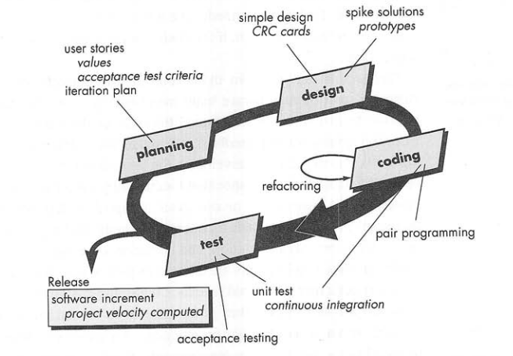
Extreme Programming

Slide 9
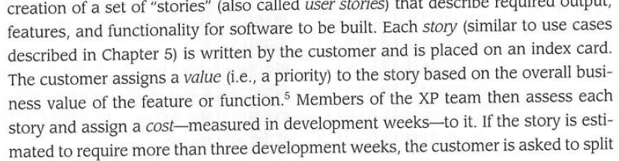
Extreme Programming

Slide 10
XP
User story
Output, features and functionality of sw to build
Customer assigns a value
XP team assigns the cost in terms of development weeks

Slide 11
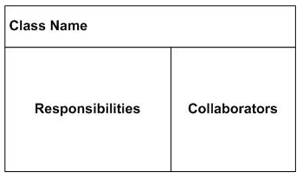
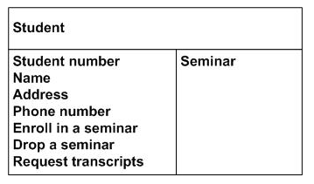
XP
CRC
Class responsibility collaborator
Object oriented class and its responsibilites for current story

Slide 12
XP
Spike solution
Operational prototype built for current story
Project velocity
Number of user stories implemented

Slide 13
Extreme Programming

